Slide 1
COMP 550 Algorithm and Analysis Correctness and Running Time Based on CLRS Sec 2.1, 2.2
Some slides are adapted from ones by prior instructors Prof. Plaisted and Prof. Osborne

Slide 2
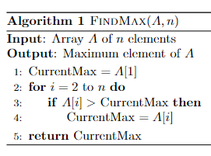
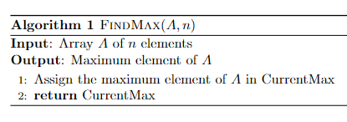
Algorithm: More Formal
A finite sequence of rigorous instructions for solving a well-specified computational problem

Slide 3
Algorithm: Formal
Alonzo Church and Alan Turing in 1936 came with formal definitions for the concept of algorithm
One definition: Turing Machine that always halts.
Other definitions: Lambda Calculus, Recursive Functions
These definitions are equivalent among each others

Slide 4
Algorithm Analysis
If we can develop an algorithm for a problem, we need to analyze it (note that some problem may be unsolvable!)
Is the algorithm correct?
Use mathematical tools
How efficient it is?
Why needed? How to measure this?

Slide 5
Algorithm Correctness Proof

Slide 6
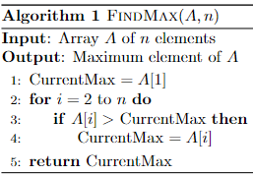
FindMax: Correctness
FindMax is correct iff
For each possible input, FindMax halts and returns the maximum of input array

Slide 7
FindMax: Correctness
Intuitive explanation $≠$ Correctness proof
An example where the algorithm works $≠$Correctness proof
Common proof techniques
Proof by Construction
Proof by Induction
Proof by Contradiction

Slide 8
FindMax: Correctness
Loop invariant
A property that is true before, during, and after a loop.
Proving a loop invariant: 3 steps
Initialization: the loop invariant is true before the loop starts.
Maintenance: if the invariant is true before one loop iteration, it remains true before the next.
Termination: The loop terminates AND the invariant gives a useful property that helps show why the algorithm is correct.

Slide 9
FindMax: Correctness
Loop invariant
(LI) At the start of each iteration of the for loop of lines 2-4, CurrentMax contains the maximum of all elements in the subarray A[1 : i-1].

Slide 10
FindMax: Correctness
Initialization
LI holds before the first iteration (when i=2)
LI with i=2: CurrentMax contains the maximum of the subarray A[1 : 1].
Proof: Due to line 1.
Loop invariant
(LI) At the start of each iteration of the for loop of lines 2-4, CurrentMax contains the maximum of all elements in the subarray A[1 : i-1].

Slide 11
FindMax: Correctness
Maintenance
LI holds before the (k+1)-th iteration assuming that it holds before the k-th iteration.
If CurrentMax contains the maximum of the subarray A[1 : k-1] before the k-th iteration, then CurrentMax contains the maximum of the sub-array A[1 : k] before the (k+1)-th iteration.
Loop invariant
(LI) At the start of each iteration of the for loop of lines 2-4, CurrentMax contains the maximum of all elements in the subarray A[1 : i-1].

Slide 12
FindMax: Correctness
Proof: We need to consider the k-th iteration.
CurrentMax holds $\max_{1≤i≤k−1}{A[i]}$before the k-th iteration (induction hypothesis).
Case 1: $∀i≤k−1,{A\left[i\right]<A[k]}$holds.
Then, $\max_{1≤i≤k−1}{A\left[i\right]<A[k]}$
By induction hypothesis, CurrentMax $<A[k]$
Line 4 assigns $A[k]$ to CurrentMax
CurrentMax $=\max_{1≤i≤k}{A\left[i\right]}$
Maintenance: If CurrentMax contains the maximum of the subarray A[1 : k-1] before the k-th iteration, then CurrentMax contains the maximum of the sub-array A[1 : k] before the (k+1)-th iteration.

Slide 13
FindMax: Correctness
Proof: We need to consider the k-th iteration.
CurrentMax holds $\max_{1≤i≤k−1}{A[i]}$before the k-th iteration (induction hypothesis).
Case 2: $∃i≤k−1,{A\left[i\right]≥A[k]}$holds.
Then, $\max_{1≤i≤k−1}{A\left[i\right]≥A[k]}$
By induction hypothesis, CurrentMax $≥A[k]$
Line 3 condition is False
CurrentMax $=\max_{1≤i≤k}{A\left[i\right]}$
i incremented by 1
Maintenance: If CurrentMax contains the maximum of the subarray A[1 : k-1] before the k-th iteration, then CurrentMax contains the maximum of the sub-array A[1 : k] before the (k+1)-th iteration.

Slide 14
FindMax: Correctness
Termination
Loop terminates when i $>$ n.
i is an integer $→$ loop terminates when i$=$n+1
At the start of (n+1)-th iteration of the for loop of lines 2-4, CurrentMax contains the maximum of all elements in the subarray A[1 : n].
Loop invariant
(LI) At the start of each iteration of the for loop of lines 2-4, CurrentMax contains the maximum of all elements in the subarray A[1 : i-1].

Slide 15
FindMax: Correctness
We also need to prove that the algorithm always halts.
Trivial here
i cannot increase beyond $n+1$
Not always easy!
Loop invariant
(LI) At the start of each iteration of the for loop of lines 2-4, CurrentMax contains the maximum of all elements in the subarray A[1 : i-1].

Slide 16
Algorithm Efficiency
There are often many approaches (algorithms) to solve a problem (Recall: Finding the maximum)
How do we choose between them?
At the heart of computer program design are two (sometimes conflicting) goals
To design an algorithm that is easy to understand, code, debug
To design an algorithm that makes efficient use of the computer’s resources

Slide 17
Algorithm Efficiency

Slide 18
Algorithm Efficiency
(1) is the concern of Software Engineering
(2) is the concern of Algorithm Analysis
Following questions are relevant for (2):
How to find the most efficient of several possible algorithms for the same problem.
Is the algorithm optimal (best in some sense)?
Can we do even better?

Slide 19
Algorithm Efficiency
Since (2) is about efficiency, what should be the metric to determine efficiency?
Computation time (a.k.a. running time)
Memory requirement
Communication bandwidth, etc.
Primary concern:
i) computation time, ii) memory requirement

Slide 20
Determining Running Time
Option 1: Empirical analysis (run executable code)
Option 2: Theoretical analysis
Which one is better?

Slide 21
Option 1: Empirical Analysis
Run executable code
Compare Alg. A and Alg. B that solve the same problem
Need to implement both
Suppose Alg. A shows takes less computation time (avg or worst?)
Alg. A might be better coded
Can run both on finite number of test cases (inputs). What if Alg. A is suitable for these inputs, but does poorly in many unseen inputs?
The computing platform may favor Alg. A

Slide 22
Option 2: Theoretical Analysis
What computing model needs to be assumed?
What should be the costs of different operations?
Running time should be determined with respect to what?
An algorithm can be represented differently, how to make the analysis independent of this dissimilarity?

Slide 23
Computing Model
Running time measurement should be machine independent
Use a hypothetical computing platform (should not be overly unrealistic)
Our assumption: Random Access Machine (RAM) model
Single processor
Executes instructions one after another (no concurrency)

Slide 24
RAM Model
Supports primitive constant-time instructions
Arithmetic (+, –, *, /, %, floor, ceiling).
Data Movement (load, store, copy).
Control (branch, subroutine call).
No complex operations supported
No sort operation (can’t assume to do it in constant time)
Simplifying assumption: run time is 1 time unit for all simple instructions.

Slide 25
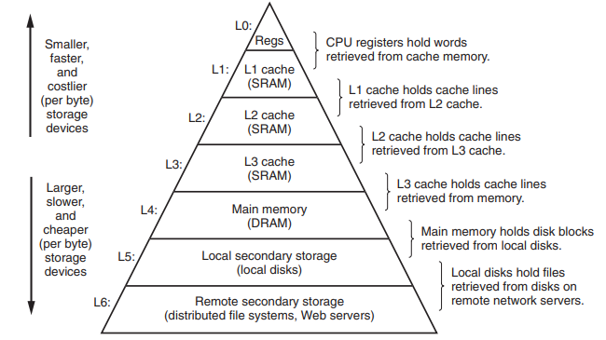
RAM Model
Memory is unlimited
No memory hierarchy
Fig. Source: Computer Systems: A Programmer's Perspective, Bryant and O’ Hallaron
1 ns
4 ns
100 ns
16k+ ns
Latency Numbers Every Programmer Should Know
https://colin-scott.github.io/personal_website/research/interactive_latency.html

Slide 26
Running Time
The running time of an algorithm on a particular input is the number of primitive operations or “steps” executed
Also called “time complexity” of the algorithm
Running time usually grows with “input size’’
Steps required to sort 1 million numbers vs 1000 numbers
Running time also depends on other input characteristics
Sorting an already sorted array

Slide 27
Input Size
Determine running time w.r.t. input size
Formally, input size depends on how input is encoded
We’ll see this later in this course
Input size depends on the problem in hand
Array problems: number of items
Graph problems: number of vertices and edges

Slide 28
Worst, Average, and Best-Case Complexity
Worst-case complexity
Maximum steps the algorithm takes for any possible input
Most tractable measure
Average-case complexity
Average number of steps for all possible inputs
Requires probability distribution of possible inputs, which is usually difficult to provide and to analyze
Best-case complexity
Minimum number of steps for any possible input
Not useful. Why?

Slide 29
Why Worst-Case Complexity?
An upper bound on the running time for any input
The algorithm never takes any longer
For some algorithms, the worst case occurs fairly often
The average case is often roughly as bad as the worst case

Slide 30
Worst-Case Complexity: Example
 | FindMax(A,n) | Cost | Times
1. | CurrentMax $←$ A[1]
2. | for i $←$ 2 to n do
3. | if A[i] $>$ CurrentMax then
4. | CurrentMax $←$ A[i]
5. | return CurrentMax

Slide 31
Worst-Case Complexity: Example
 | FindMax(A,n) | Cost | Times
1. | CurrentMax $←$ A[1] | $$c_{1}$$ | $$1$$
2. | for i $←$ 2 to n do | $$c_{2}$$
3. | if A[i] $>$ CurrentMax then | $$c_{3}$$
4. | CurrentMax $←$ A[i] | $$c_{4}$$
5. | return CurrentMax | $$c_{5}$$

Slide 32
Worst-Case Complexity: Example
 | FindMax(A,n) | Cost | Times
1. | CurrentMax $←$ A[1] | $$c_{1}$$ | $$1$$
2. | for i $←$ 2 to n do | $$c_{2}$$ | $$n$$
3. | if A[i] $>$ CurrentMax then | $$c_{3}$$
4. | CurrentMax $←$ A[i] | $$c_{4}$$
5. | return CurrentMax | $$c_{5}$$

Slide 33
Worst-Case Complexity: Example
 | FindMax(A,n) | Cost | Times
1. | CurrentMax $←$ A[1] | $$c_{1}$$ | $$1$$
2. | for i $←$ 2 to n do | $$c_{2}$$ | $$n$$
3. | if A[i] $>$ CurrentMax then | $$c_{3}$$ | $$n−1$$
4. | CurrentMax $←$ A[i] | $$c_{4}$$
5. | return CurrentMax | $$c_{5}$$
In the worst-case, how many times line 4 executes?

Slide 34
Worst-Case Complexity: Example
 | FindMax(A,n) | Cost | Times
1. | CurrentMax $←$ A[1] | $$c_{1}$$ | $$1$$
2. | for i $←$ 2 to n do | $$c_{2}$$ | $$n$$
3. | if A[i] $>$ CurrentMax then | $$c_{3}$$ | $$n−1$$
4. | CurrentMax $←$ A[i] | $$c_{4}$$ | $$n−1$$
5. | return CurrentMax | $$c_{5}$$ | $$1$$
Worst-case running time, $T(n) =c_{1}+c_{2}⋅n+c_{3}⋅\left(n−1\right)+c_{4}⋅\left(n−1\right)+c_{5}$
$=\left(c_{2}+c_{3}+c_{4}\right)⋅n+c_{1}−c_{3}−c_{4}+c_{5}$
$=a⋅n+b$

Slide 35
Best-Case Complexity: Example
 | FindMax(A,n) | Cost | Times
1. | CurrentMax $←$ A[1] | $$c_{1}$$ | $$1$$
2. | for i $←$ 2 to n do | $$c_{2}$$ | $$n$$
3. | if A[i] $>$ CurrentMax then | $$c_{3}$$ | $$n−1$$
4. | CurrentMax $←$ A[i] | $$c_{4}$$ | ?
5. | return CurrentMax | $$c_{5}$$ | $$1$$
In the best-case, how many times line 4 executes?

Slide 36
Best-Case Complexity: Example
 | FindMax(A,n) | Cost | Times
1. | CurrentMax $←$ A[1] | $$c_{1}$$ | $$1$$
2. | for i $←$ 2 to n do | $$c_{2}$$ | $$n$$
3. | if A[i] $>$ CurrentMax then | $$c_{3}$$ | $$n−1$$
4. | CurrentMax $←$ A[i] | $$c_{4}$$ | 0
5. | return CurrentMax | $$c_{5}$$ | $$1$$
Best-case running time, $T(n) =c_{1}+c_{2}⋅n+c_{3}⋅\left(n−1\right)+c_{4}⋅0+c_{5}$
$=\left(c_{2}+c_{3}+c_{4}\right)⋅n+c_{1}−c_{3}+c_{5}$
$=a⋅n+b$

Slide 37
Average-Case Complexity: Example
 | FindMax(A,n) | Cost | Times
1. | CurrentMax $←$ A[1] | $$c_{1}$$ | $$1$$
2. | for i $←$ 2 to n do | $$c_{2}$$ | $$n$$
3. | if A[i] $>$ CurrentMax then | $$c_{3}$$ | $$n−1$$
4. | CurrentMax $←$ A[i] | $$c_{4}$$ | $$x$$
5. | return CurrentMax | $$c_{5}$$ | $$1$$
Avg-case running time, $T(n)=c_{1}+c_{2}⋅n+c_{3}⋅\left(n−1\right)+c_{4}⋅E[x]+c_{5}$
$=\left(c_{2}+c_{3}\right)⋅n+c_{1}−c_{3}+c_{4}⋅\frac{\sum_{i=0}^{n−1}{i}}{n}+c_{5}$

Slide 38
Insertion Sort: Time Complexity
Goal: evaluate $\sum_{i=0}^{n−1}{i}$
$$\sum_{i=0}^{n−1}{i}=\sum_{i=1}^{n−1}{i}=\frac{\left(n−1\right)n }{2}$$
The summation
$$\sum_{k=1}^{n}{k}=1+2+…+n$$
is an arithmetic series and has the value
$$\sum_{k=1}^{n}{k}=\frac{n(n+1)}{2}$$
Evaluating the sums
Appendix A: Summations

Slide 39
Average-Case Complexity: Example
 | FindMax(A,n) | Cost | Times
1. | CurrentMax $←$ A[1] | $$c_{1}$$ | $$1$$
2. | for i $←$ 2 to n do | $$c_{2}$$ | $$n$$
3. | if A[i] $>$ CurrentMax then | $$c_{3}$$ | $$n−1$$
4. | CurrentMax $←$ A[i] | $$c_{4}$$ | $$x$$
5. | return CurrentMax | $$c_{5}$$ | $$1$$
Avg-case running time, $T(n)=c_{1}+c_{2}⋅n+c_{3}⋅\left(n−1\right)+c_{4}⋅E[x]+c_{5}$
$=\left(c_{2}+c_{3}\right)⋅n+c_{1}−c_{3}+c_{4}⋅\frac{\sum_{i=0}^{n−1}{i}}{n}+c_{5}$
$=\left(c_{2}+c_{3}\right)⋅n+c_{1}−c_{3}+c_{4}⋅\frac{\left(n−1\right)⋅n}{n⋅2}+c_{5}$
$=$ $a⋅n+b$

Slide 40
Searching Problem
Find an element in a sequence of numbers
Input: A sequence of $n$ numbers $\left\langle a_{1},a_{2},…,a_{n}\right\rangle$and a $key$
Output: True if $∃k∈\left\{1..n\right\} :key=a_{k},$False otherwise
Example:
Input: $\left\langle \text{31, 41, 59, 26, 41, 58}\right\rangle , 59$
Output: True

Slide 41
Linear Search
 | LinearSearch(A,n,key) | Cost | Times
1. | i $=$ 1
2. | while i $≤$ n and A[i] $≠$ key do
3. | i $=$ i $+$1
4. | if i $≤$ n then
5. | return True
6. | return False
Try at home: Correctness proof by loop invariant.

Slide 42
Linear Search: Worst-Case
 | LinearSearch(A,n,key) | Cost | Times
1. | i $=$ 1 | $$c_{1}$$ | $$1$$
2. | while i $≤$ n and A[i] $≠$ key do | $$c_{2}$$ | $$x$$
3. | i $=$ i $+$1 | $$c_{3}$$ | $$x−1$$
4. | if i $≤$ n then | $$c_{4}$$ | $$1$$
5. | return True | $$c_{5}$$ | $$1$$
6. | return False | $$c_{6}$$ | $$1$$
$x$is an integer between $1$ and $n+1$
Worst case: $x=n+1$
Best case: $x=1$
Average case: $x=n/2$

Slide 43
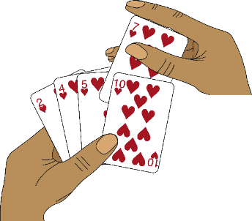
Insertion Sort
Informal description:
Iterate the array from the first element
If the current element is in wrong place w.r.t. already seen elements, move it to its correct place

Slide 44
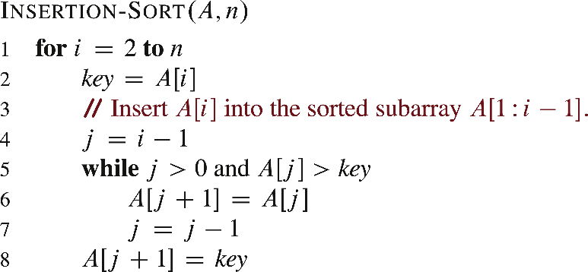
Insertion Sort
From CLRS 4th edition

Slide 45
Insertion Sort
key
5 | 2 | 4 | 6 | 1 | 3
key
2 | 5 | 4 | 6 | 1 | 3
key
2 | 4 | 5 | 6 | 1 | 3
key
2 | 4 | 5 | 6 | 1 | 3
key
1 | 2 | 4 | 5 | 6 | 3
1 | 2 | 3 | 4 | 5 | 6

Slide 46
Insertion Sort: Correctness
Loop invariant
(LI) At the start of each iteration of the for loop of lines 1-8, the subarray A[1 : i-1] consists of all elements originally in A[1 : i-1] and A[1 : i-1] is sorted.

Slide 47
Insertion Sort: Correctness
Initialization
LI holds before the first iteration (when i=2)
LI with i=2: The subarray A[1 : 1] consists of all elements originally in A[1 : 1] and A[1 : 1] is sorted.
Proof: Trivially true.
Loop invariant
(LI) At the start of each iteration of the for loop of lines 1-8, the subarray A[1 : i-1] consists of all elements originally in A[1 : i-1] and A[1 : i-1] is sorted.

Slide 48
Insertion Sort: Correctness
Maintenance
LI holds before the (k+1)-th iteration assuming it holds before the k-th iteration.
If the subarray A[1 : k-1] is sorted before the k-th iteration, then A[1 : k] is sorted before the (k+1)-th iteration.
Loop invariant
(LI) At the start of each iteration of the for loop of lines 1-8, the subarray A[1 : i-1] consists of all elements originally in A[1 : i-1] and A[1 : i-1] is sorted.

Slide 49
Insertion Sort: Correctness
Proof: We need to consider the k-th iteration.
A[1:k-1] is already sorted before that.
Let k* $<$ k be the last index such that A[j] $≤$ A[k] for all j $≤$ k*. (Loop breaks at j=k*).
k* = 0 if A[j] $>$ A[k] for all j $<$ k+1.
Lines 5-7 shifts each A[j] with k* $<$ j $<$k to one position right.
Line 8 moves key to A[k*+1].
i increments by 1
Maintenance: If the subarray A[1 : k] is sorted before the k-th iteration, then A[1 : k+1] is sorted before the (k+1)-th iteration.
Informal!

Slide 50
Insertion Sort: Correctness
Termination
Loop terminates when i $>$ n.
i is an integer $→$ loop terminates when i$=$n+1
At the start of (n+1)-th iteration of the for loop of lines 1-8, the subarray A[1 : n] consists of all elements originally in A[1 : n] and A[1 : n] is sorted.
Loop invariant
(LI) At the start of each iteration of the for loop of lines 1-8, the subarray A[1 : i-1] consists of all elements originally in A[1 : i-1] and A[1 : i-1] is sorted.

Slide 51
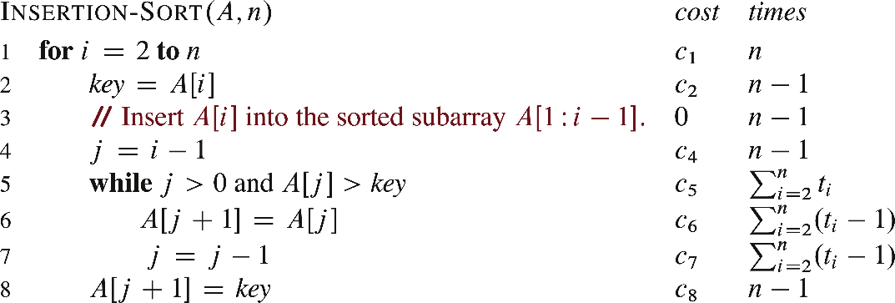
Insertion Sort: Time Complexity
$t_{i}$:
How many while loop tests for current value of i
Running time, $T\left(n\right)=c_{1}⋅n+c_{2}\left(n−1\right)+c_{4}\left(n−1\right)+c_{5}⋅\sum_{i=2}^{n}{t_{i}}+$
$c_{6}⋅\sum_{i=2}^{n}{{(t}_{i}−1)}+c_{7}⋅\sum_{i=2}^{n}{{(t}_{i}−1)}+c_{8}(n−1)$
$=(c_{1}+c_{2}+c_{4}+c_{8}) n+ c_{5}⋅\sum_{i=2}^{n}{t_{i}}+(c_{6}+c_{7}) \sum_{i=2}^{n}{{(t}_{i}−1)}$
$$−(c_{2}+c_{4}+c_{8})$$
$=a⋅n+c_{5}⋅\sum_{i=2}^{n}{t_{i}}+(c_{6}+c_{7}) \sum_{i=2}^{n}{{(t}_{i}−1)+b}$

Slide 52
Insertion Sort: Time Complexity
$t_{i}$:
How many while loop tests for current value of i
Question: When do the best and worst cases occur?

Slide 53
Insertion Sort: Time Complexity
$t_{i}$:
How many while loop tests for current value of i
Best Case: Already sorted array. Why?
Lines 6,7 never executes. $t_{i}=1$
In the best case, $T\left(n\right)=a⋅n+c_{5}⋅\sum_{i=2}^{n}{t_{i}}+(c_{6}+c_{7}) \sum_{i=2}^{n}{{(t}_{i}−1)+b}$
$=a⋅n+c_{5}⋅\left(n−1\right)+b=a^{′}⋅n+b^{′}$

Slide 54
Insertion Sort: Time Complexity
$t_{i}$:
How many while loop tests for current value of i
Worst Case: Reverse sorted array. Why?
Lines 5 executes until $j=0.$So, executes for $j=i−1, i−2, …, 0.$
$$t_{i}=i$$
So, line 5 executes $\sum_{i=2}^{n}{i}$, lines 6 and 7 each execute $\sum_{i=2}^{n}{(i−1)}$times.

Slide 55
Insertion Sort: Time Complexity
Goal: evaluate $\sum_{i=2}^{n}{i}$ and $\sum_{i=2}^{n}{(i−1)}$
$$\sum_{i=2}^{n}{i}=\sum_{i=1}^{n}{i} −1=\frac{n\left(n+1\right)}{2}−1$$
$$\sum_{i=2}^{n}{\left(i−1\right)=\sum_{i=1}^{n−1}{i}=\frac{\left(n−1\right)n}{2}}$$
The summation
$$\sum_{k=1}^{n}{k}=1+2+…+n$$
is an arithmetic series and has the value
$$\sum_{k=1}^{n}{k}=\frac{n(n+1)}{2}$$
Evaluating the sums
Appendix A: Summations

Slide 56
Insertion Sort: Time Complexity
In the worst case,
$$T\left(n\right)=a⋅n+c_{5}⋅\sum_{i=2}^{n}{t_{i}}+(c_{6}+c_{7}) \sum_{i=2}^{n}{{(t}_{i}−1)+b}$$
$=a⋅n+c_{5}\left(\frac{n\left(n+1\right)}{2}−1\right)+$ $\left(c_{6}+c_{7}\right)\left(\frac{n\left(n−1\right)}{2}\right)+b$
$=(\frac{c_{5}+c_{6}+c_{7}}{2}{)n}^{2}+\left(a+\frac{c_{5}−c_{6}−c_{7}}{2}\right)n+b−c_{5}$
$=a^{′}n^{2}+b^{′}n+c′$

Slide 57
Order of Growth
Principal interest is to determine
How running time grows with input size: Order of growth.
The running time for large inputs: Asymptotic complexity.
Running time growth as input size goes to $∞$
Lower-order terms and coefficient of the highest-order term are insignificant.
In 3n³+7n+1, which term dominates the running time for very large n?
Above running time is $Θ(n^{3})$

Slide 58
Order of Growth
Express the worst- and best-case running times of
FindMax
Linear Search
Insertion Sort

Slide 59
Thank You!

